Slide 1

PRESENTATION ON A-
“CHATBOT FOR JAVA”
BY-
DEBOSMITA GHOSH(62)
RUDRA PRASAD SIKDAR(63)
SANGITA MONDAL(65)

Slide 2

INDEX
What is chatbot?
Introduction to Java swing
Project Overview
Design Of Our Project
Features Of the Chatbot
Our Future Aspect
Conclusion

Slide 3
TOCIN
WHAT IS CHATBOT?
A chatbot is a computer program designed to simulate conversation with human users, especially over the Internet. It uses natural language processing (NLP) to understand and interpret user inputs, and it generates responses in a way that simulates a conversation. Chatbots can be used for a variety of purposes, such as providing customer support, answering frequently asked questions, assisting with tasks, or even engaging in casual conversation.
There are different types of chatbots, ranging from rule-based systems that follow pre-defined scripts to more advanced models that use machine learning and artificial intelligence techniques to understand and respond to user inputs. Some chatbots are designed for specific domains and have a narrow focus, while others are more general-purpose and can handle a wide range of topics.
Chatbots can be implemented on various platforms, including websites, messaging apps, and social media platforms. They play a significant role in automating and improving user interactions, providing a more efficient and convenient way for people to access information and services.

Slide 4
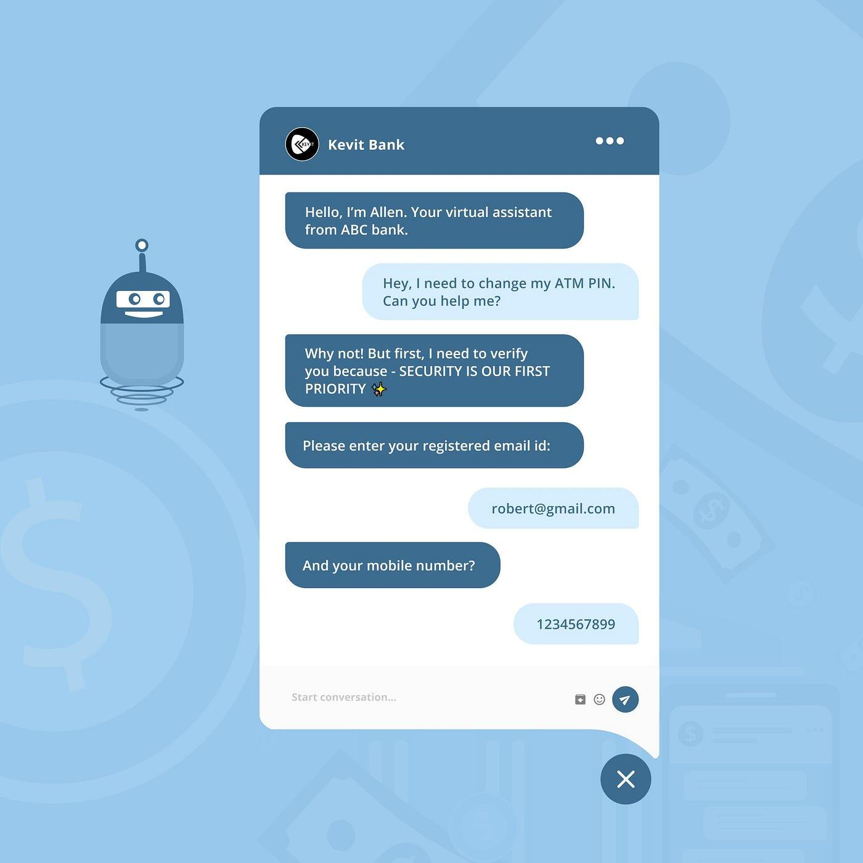
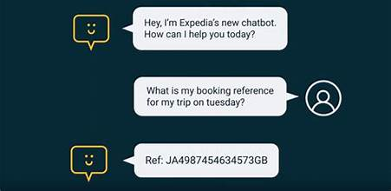
Presentation tittle
INTRODUCTION TO JAVA SWING
Java Swing is a graphical user interface (GUI) toolkit for Java that provides a comprehensive set of components for building desktop applications. Part of the Java Foundation Classes (JFC), Swing is designed to be platform-independent, allowing developers to create applications that can run on any system with a Java Virtual Machine (JVM). It offers a rich set of GUI components, features, and tools for creating interactive and visually appealing user interfaces.
If you are building a chatbot in Java, you might use Swing to create the graphical interface through which users interact with the chatbot. The Swing components, such as text fields, labels, and buttons, can be used to design a user-friendly interface for entering messages, displaying chat history, and interacting with the chatbot.
Swing can be used to create the graphical interface for a chatbot application, allowing users to interact with the chatbot through a visually appealing and user-friendly interface. The chatbot functionality, including the NLP and response generation, would be implemented using other Java libraries or frameworks.

Slide 5
PROJECT OVERVIEW
Swing (Java Swing) for building the graphical user interface. Swing provides a platform-independent and customizable framework for creating interactive and visually appealing interfaces.
The primary goal is to create a chatbot that can automate customer support interactions, providing quick and accurate responses to user queries
The chatbot for java is designed to handle general queries related to a java language
Targeted towards end-users who seek quick information, assistance, or support within the specified domain. The chatbot aims to provide a user-friendly interface accessible to individuals with varying technical expertise.

Slide 6
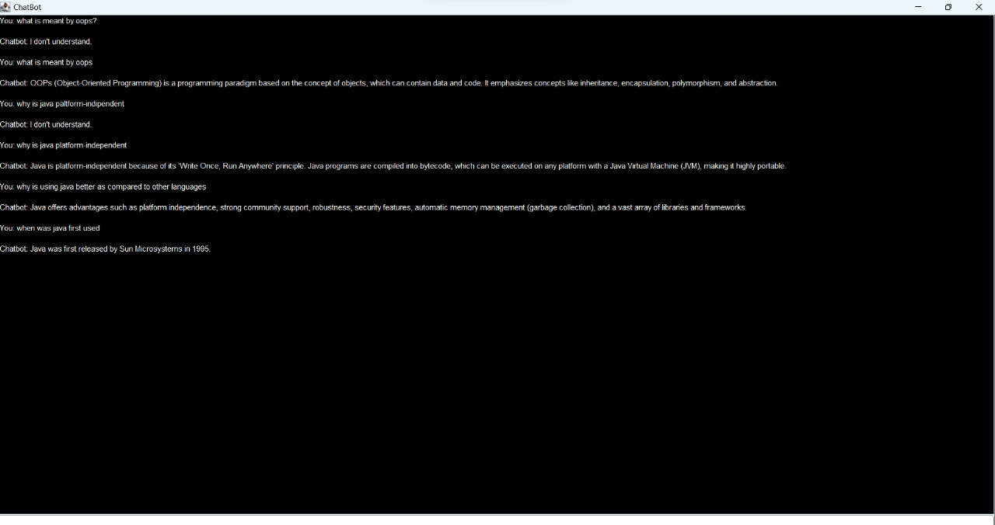
DESIGN OF OUR PROJECT

Slide 7
FEATURES OF THE CHATBOT
For today’s consumer, bot-based support is a logical use case
Customers have migrated toward self-service, preferring not to deal with human agents as the earlier chart demonstrates
In fact, 90% of consumers say they now expect brands and organizations to have a self-service option
Customers either want to solve their issue quickly on their own, or receive an immediate response
But these bots don’t have to be customer facing to create significant value for businesses

Slide 8
OUR FUTURE ASPECT
Extensive Answer Database:
Expand the chatbot's answer database to cover a broader range of Java-related topics, providing users with comprehensive and in-depth responses.
Coding Challenges and Exercises:
Introduce a dedicated section for coding challenges and exercises to help users practice and enhance their Java programming skills within the chatbot platform.
Java Question Papers:
Provide curated sets of Java-related question papers, enabling users to test their knowledge, prepare for exams, or evaluate their understanding of Java concepts.
Interview Preparation:
Develop an interview preparation module that offers guidance on common Java interview questions, coding assessments, and tips for a successful Java-related job interview.
Interactive Learning Paths:
Create interactive learning paths or courses within the chatbot, guiding users through structured lessons covering various Java topics, from basics to advanced concepts.
Community-Driven Content:
Foster a community-driven content creation model, allowing users to contribute coding challenges, question papers, and interview insights, creating a collaborative learning environment.

Slide 9
CONCLUSION
The Chatbot project successfully delivers comprehensive support for Java-related queries, offering a one-stop solution for users seeking assistance with Java programming.
Through its user-friendly interface and interactive features, the chatbot ensures meaningful engagement and effective interaction with Java users, catering to their diverse needs.
The incorporation of learning resources, coding challenges, and real-time assistance fosters continuous learning among users, contributing to skill enhancement in the Java domain.
The chatbot's round-the-clock availability ensures users can access Java-related support whenever they need it, facilitating a seamless and responsive user experience.
Users benefit from the chatbot's quick response times and resourceful assistance, saving time and enhancing productivity in their Java-related tasks and projects.

Slide 10
THANK YOU

